Slide 1
Global Inflation Insights Hub

Slide 2
Tech Stack:
Language: Python
Data Analysis: Numpy, Pandas
Code Editor: VSCode
SQLite
Purpose:
Create an interactive platform for global inflation analysis.
Uncover insights, identify patterns, aid decision-making.
Functionalities:
CRUD Operations:
Create: Ingest and process financial data feeds.
Read: Provide interactive dashboards, queries, and reports.
Update: Implement periodic dataset updates.
Delete: Manage outdated data for accuracy.
Constraints:
Implement data quality checks during ingestion and processing.

Slide 3
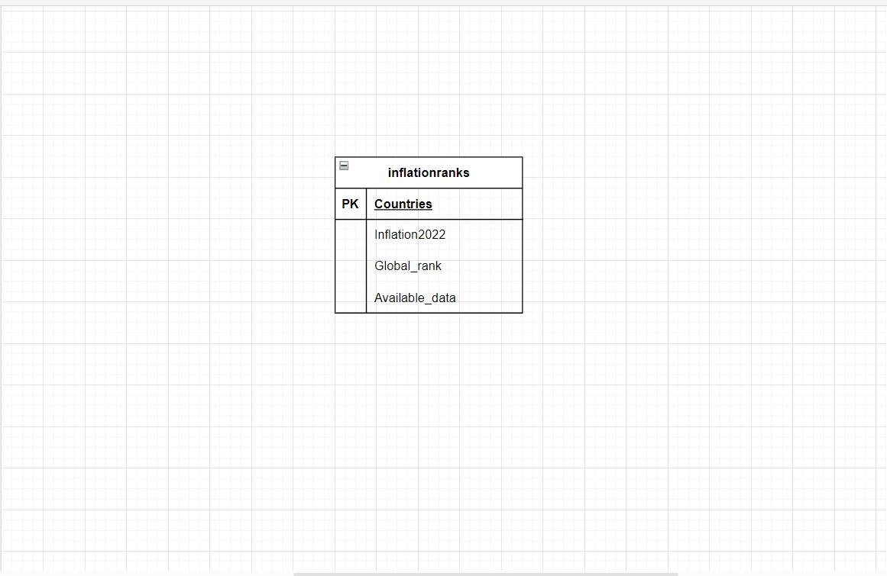
ER DIAGRAM

Slide 4
Github link:
https://github.com/Afshanjabeen77/Revature.git

Slide 5
CHALLENGES FACED DURING PROJECT:
Database Schema Design: Designing an effective SQLite database schema to store inflation data while considering performance and data retrieval efficiency.
Query Performance: Ensuring that SQL queries are optimized for efficient data retrieval.
Error Handling: Managing errors during data ingestion and processing to prevent data corruption.
Access Control: Managing user access to ensure only authorized individuals can interact with and modify the data.
Clean Code Practices: Maintaining a clean and organized Python codebase for better readability and future maintenance.

Slide 6
THANK YOU

